Slide 1


AN AMPLIFLY INNOVATIONS COMPANY
Home of Cyber
Training | Placement | Consultancy
Cybersecurity, AI and full-stack engineering from one accountable partner, built for enterprises that can't afford a breach.
SOC
VAPT
IAM
Cloud
GRC
AI
Full-Stack
A BRAND OF AMPLIFLY INNOVATIONS PVT. LTD.
homeofcyber.com | ampliflytech.com
Notes:
Open with the one-line promise: one partner to defend, test and build. Home of Cyber is the cybersecurity brand of Amplifly Innovations, headquartered in Hyderabad: training, placement and consultancy.

Slide 2
WHO WE ARE
Amplifly Innovations
“Technology that makes everyday life lighter.”
Aug 2026
Incorporated, headquartered in Hyderabad
Vision: to make everyday life lighter for a billion people, with technology so simple it disappears.
DPIIT
Recognised startup under Startup India
Mission: build honest, beautifully simple products that solve real problems, and bring the same craft to every partner we work with.
4 brands
Erinsoft · Genboat · Home of Cyber · Amplifly
AMPLIFLY INNOVATIONS × HOME OF CYBER
homeofcyber.com | ampliflytech.com
02 / 19
Notes:
Amplifly Innovations Private Limited is the registered parent company, a DPIIT-recognised startup based in Hyderabad. Four brands operate under it: Erinsoft for software development, Genboat for AI, Home of Cyber for cybersecurity, and Amplifly itself for food and beverages.

Slide 3





WHAT WE ARE
One company, four focused brands
DEVELOPMENT
AI
CYBERSECURITY
FOOD AND BEVERAGES
Erinsoft
Genboat
Home of Cyber
Amplifly
Custom web, mobile and digital engineering for businesses.
GenAI copilots, AI agents, machine learning and AI security.
Training, placement and consultancy in cybersecurity.
Food technology, starting with DIYSH daily breakfast delivery.
erinsoft.com
Registered brand
homeofcyber.com
ampliflytech.com
All four brands operate under Amplifly Innovations Private Limited, one registration and one accountable team.
AMPLIFLY INNOVATIONS × HOME OF CYBER
homeofcyber.com | ampliflytech.com
03 / 19
Notes:
The group structure. Erinsoft builds software, Genboat builds AI, Home of Cyber secures and trains, and Amplifly runs the food and beverages business. All four sit under the same registered company, so clients contract with one entity.

Slide 4
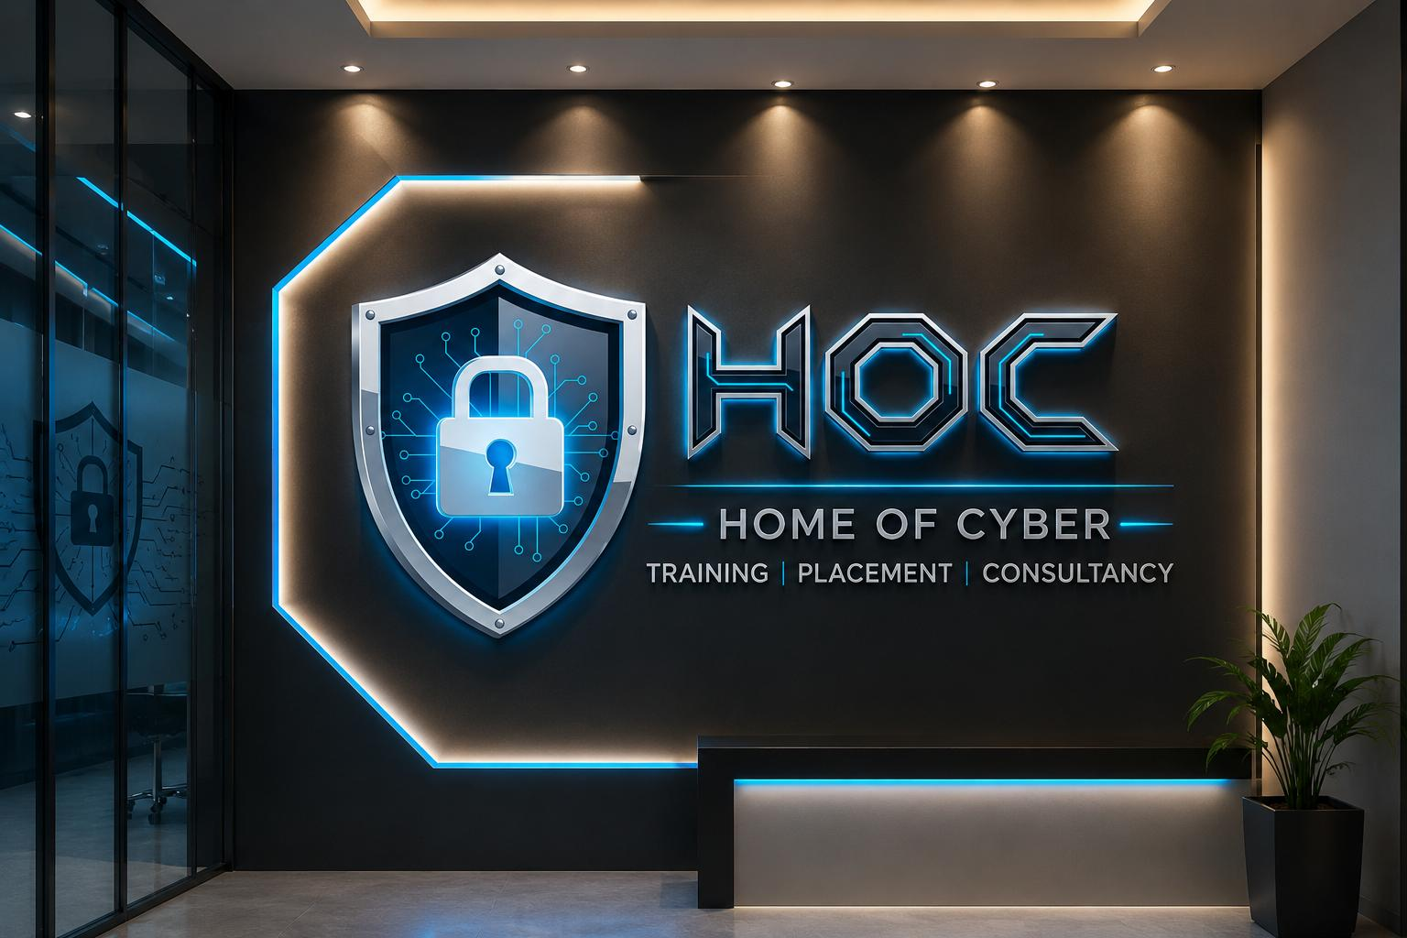




INTRODUCING
Home of Cyber (HOC)
Training | Placement | Consultancy
Amplifly's cybersecurity brand. We defend your business around the clock, test it the way an attacker would, and train the people who keep it safe.
Train
Place
Defend
Attack
Hands-on programs from beginner to C|CISO
Job-ready analysts for your security teams
Managed SOC, IAM, cloud and compliance
VAPT and red teaming before adversaries do
AMPLIFLY INNOVATIONS × HOME OF CYBER
homeofcyber.com | ampliflytech.com
04 / 19
Notes:
Home of Cyber: Training, Placement, Consultancy. The academy trains talent and places it; the consultancy defends and tests client environments. AI and software builds come from sister brands Genboat and Erinsoft.

Slide 5




THE CHALLENGE
Security is now a board-level risk
Attack surface keeps growing
Security talent is scarce
Regulation is tightening
Too many vendors
Cloud, SaaS, APIs, remote work and now AI models widen exposure every quarter.
Skilled SOC analysts and pentesters are hard to hire and harder to keep.
DPDP Act 2023, CERT‑In's 6-hour incident reporting, RBI and SEBI cyber frameworks.
Security, cloud and app work split across vendors leave gaps nobody owns.
Enterprises need one partner that can defend, test and build, securely.
AMPLIFLY INNOVATIONS × HOME OF CYBER
homeofcyber.com | ampliflytech.com
05 / 19
Notes:
Four pressures we hear from every CISO and CTO: a growing attack surface, a talent shortage, tighter Indian regulation (DPDP Act 2023, CERT-In's April 2022 directions requiring incident reporting within 6 hours, and RBI and SEBI frameworks), and fragmented vendors.

Slide 6


WHAT WE DELIVER
One portfolio, three practices
Cyber Defense
AI and Engineering
HOC Academy
BY HOME OF CYBER
BY GENBOAT AND ERINSOFT
TRAINING AND PLACEMENT
Managed SOC and MDR
VAPT and red teaming
Identity and access (IAM/PAM)
Cloud and network security
GRC and compliance
DFIR and malware analysis
GenAI copilots and RAG
AI agents and automation
Web and mobile apps
APIs and cloud backends
DevSecOps and CI/CD
UI/UX and brand design
Ethical hacking and pentest
SOC analyst program
Malware and forensics
Cloud and network security
Corporate upskilling
Security awareness
AMPLIFLY INNOVATIONS × HOME OF CYBER
homeofcyber.com | ampliflytech.com
06 / 19
Notes:
The complete service catalogue at a glance. The next slides go through each practice in detail.

Slide 7






CYBER DEFENSE · SECURITY OPERATIONS
Managed SOC and MDR
24×7 Monitoring
SIEM and SOAR
Threat Hunting
Round-the-clock alert triage across endpoint, network, cloud and SaaS logs.
Deploy and tune SIEM use cases; automate response with playbooks.
Hypothesis-driven hunts mapped to MITRE ATT&CK to catch what alerts miss.
Threat Intelligence
Incident Response
EDR / XDR
IOC feeds, dark-web and brand monitoring wired straight into detections.
Contain, eradicate and recover, with CERT‑In aligned incident reporting.
Policy tuning, host isolation and remediation on your endpoint stack.
STACK
Splunk
Microsoft Sentinel
Elastic
Wazuh
IBM QRadar
CrowdStrike
AMPLIFLY INNOVATIONS × HOME OF CYBER
homeofcyber.com | ampliflytech.com
07 / 19
Notes:
SOC as a service. We can run on the client's existing SIEM or deploy one. Mention that incident reporting is aligned with CERT-In's 6-hour window.

Slide 8





CYBER DEFENSE · OFFENSIVE SECURITY
VAPT and Red Teaming
Web Applications
Mobile and API
Network and Infra
OWASP Top 10, business-logic abuse, auth and session flaws.
Android and iOS apps per OWASP MASVS; REST and GraphQL APIs.
External and internal pentests, AD attack paths, wireless and firewalls.
Cloud Config
Red Teaming
Code and OT
AWS, Azure and GCP misconfigurations, excess privilege and exposure.
Goal-based adversary simulation, phishing and social engineering.
Secure source-code review (SAST/DAST) and ICS/SCADA assessments.
METHOD
OWASP
PTES
NIST SP 800-115
MITRE ATT&CK
Executive + technical report
AMPLIFLY INNOVATIONS × HOME OF CYBER
homeofcyber.com | ampliflytech.com
08 / 19
Notes:
Vulnerability assessment and penetration testing across every layer. Each engagement ends with an executive summary for leadership and a technical report with reproduction steps and fixes for engineers.

Slide 9


CYBER DEFENSE · IDENTITY
Identity and Access Management
SSO and MFA
Privileged Access
Governance (IGA)
Single sign-on and phishing-resistant MFA across cloud and on-prem apps.
PAM vaulting, just-in-time admin access and session recording.
Joiner-mover-leaver automation, access reviews and SoD rules.
Zero Trust
Directory Hardening
Customer IAM
Identity-centric, least-privilege access for users, devices and workloads.
Active Directory and Entra ID assessments, tiering and cleanup.
Secure sign-up, login and consent flows for your customer apps.
STACK
Microsoft Entra ID
Okta
CyberArk
SailPoint
Keycloak
Ping Identity
AMPLIFLY INNOVATIONS × HOME OF CYBER
homeofcyber.com | ampliflytech.com
09 / 19
Notes:
Identity is the new perimeter. We design, deploy and run IAM on whichever platform the client already uses.

Slide 10





CYBER DEFENSE · INFRASTRUCTURE
Cloud, Network and Forensics
Cloud Posture
Containers, K8s
DevSecOps
CSPM and CNAPP reviews and hardening for AWS, Azure and GCP.
Image scanning, cluster hardening and runtime protection.
Security gates in CI/CD: SAST, DAST, SCA, secrets and IaC scanning.
Network Security
DFIR
Malware Analysis
Firewall, segmentation, VPN and secure SD-WAN architecture.
Digital, mobile and network forensics with evidence-grade handling.
Static and dynamic analysis and reverse engineering of live threats.
PLATFORMS
AWS
Azure
GCP
Kubernetes
Terraform
IDA Pro
AMPLIFLY INNOVATIONS × HOME OF CYBER
homeofcyber.com | ampliflytech.com
10 / 19
Notes:
Infrastructure security from cloud posture to containers, plus investigation capability when something does go wrong: digital forensics and malware reverse engineering.

Slide 11


CYBER DEFENSE · COMPLIANCE
Governance, Risk and Compliance
Gap Assessments
Audit Readiness
Policies, ISMS
Readiness checks against your target framework.
Controls, evidence and support through the audit.
Policies written for how you actually work.
Third-Party Risk
Virtual CISO
Awareness
Risk registers, vendor scoring and reviews.
Fractional security leadership for your board.
Phishing simulations and role-based training.
FRAMEWORKS
ISO/IEC 27001
SOC 2
PCI DSS
DPDP Act
GDPR
HIPAA
CERT‑In
RBI
SEBI CSCRF
NIST CSF
AMPLIFLY INNOVATIONS × HOME OF CYBER
homeofcyber.com | ampliflytech.com
11 / 19
Notes:
GRC: we get clients audit-ready and keep them there, with Indian regulation (DPDP Act, CERT-In, RBI, SEBI CSCRF) alongside global frameworks.

Slide 12





GENBOAT · OUR AI BRAND
AI solutions, secure by default
GenAI Copilots
AI Agents
Predictive ML
Assistants over your documents, tickets and knowledge base, built with RAG.
Agents that run multi-step workflows across your tools and APIs.
Forecasting, anomaly detection and scoring models on your data.
AI for Security
LLM Red Teaming
AI Governance
Automated alert triage, phishing detection and log summarisation.
Prompt-injection, jailbreak and data-leak testing per OWASP LLM Top 10.
Responsible-AI policy, model risk reviews and ISO/IEC 42001 readiness.
STACK
Claude
GPT
Llama
LangChain
Vector DBs
Python
AMPLIFLY INNOVATIONS × HOME OF CYBER
homeofcyber.com | ampliflytech.com
12 / 19
Notes:
Where our AI and security practices meet: we build AI products, use AI in our SOC, and secure other teams' AI systems. The top row is building AI; the bottom row is securing and governing it.

Slide 13







ERINSOFT · SOFTWARE DEVELOPMENT
Products engineered end to end
Web Platforms
Mobile Apps
APIs, Backends
Fast, search-friendly web apps and portals in React and Next.js.
Native Android and iOS apps, plus Flutter and hybrid builds.
Scalable Node.js and Python services, databases and integrations.
Cloud, DevOps
UI/UX, Brand
Secure SDLC
Containerised, automated deployments with cost-aware cloud infra.
Identity, interface and content crafted around real users.
Threat modelling, code review and a pentest before major releases.
Websites: custom, e-commerce, landing and community sites · Apps: Android, iOS, Flutter, hybrid
AMPLIFLY INNOVATIONS × HOME OF CYBER
homeofcyber.com | ampliflytech.com
13 / 19
Notes:
The same team that builds Amplifly's own products builds for clients. Every build is covered by our security practice, so security isn't bolted on later.

Slide 14
ERINSOFT AND AMPLIFLY · SELECTED WORK
Products we have shipped
Artisan Express
Driver
Partex
Gigzio
Artisan booking marketplace app
Fleet and driver management app
Logistics and parcel tracking app
Job search platform
Glowsy
House of Deliverance
OCXEE
Leaderbridge
Beauty and wellness app
Mental wellness app
Global student services platform
Professional networking platform
VTalks
FE Group
DIYSH
Acupuncture Academy
Virtual talks and webinars
Finance and consultancy website
Daily breakfast planning and delivery
Classical Acupuncture Academy website
AMPLIFLY INNOVATIONS × HOME OF CYBER
homeofcyber.com | ampliflytech.com
14 / 19
Notes:
The first ten were built by Erinsoft for clients across marketplaces, logistics, jobs, wellness, education and finance. The two amber cards are Amplifly's own: DIYSH, our breakfast platform, and the Classical Acupuncture Academy website.

Slide 15
HOC ACADEMY · TRAINING | PLACEMENT | CONSULTANCY
Building the security workforce
Program | Duration | Level
Ethical Hacking and Pentest | 6 months | Beginner to Advanced
SOC Analyst | 4 months | Beginner to Intermediate
Malware Analysis and RE | 5 months | Intermediate to Advanced
Digital Forensics | 4 months | Beginner to Intermediate
Network Security | 3 months | Beginner to Intermediate
Cloud Security | 3 months | Intermediate
For enterprises
Custom upskilling batches for IT and security teams
A pipeline of job-ready SOC analysts and pentesters
Security awareness for all staff
CAREER PATH
Foundational
→
Entry (CEH)
→
Core
→
Specialist
→
Executive (C|CISO)
AMPLIFLY INNOVATIONS × HOME OF CYBER
homeofcyber.com | ampliflytech.com
15 / 19
Notes:
HOC Academy runs hands-on programs aligned to industry certifications such as CEH, CISSP and C|CISO, with weekday, weekend, online and hybrid batches. For enterprise clients it doubles as an upskilling and hiring channel.

Slide 16
HOW WE WORK
From first call to continuous protection
01
02
03
04
05
Discover
Assess
Remediate
Monitor
Improve
Your business, assets and risk appetite.
VAPT, posture and compliance gaps.
Fix, harden and build securely.
24×7 SOC over your environment.
Quarterly reviews, retests, roadmap.
ENGAGEMENT MODELS
Project
Managed
Advisory
Dedicated
Fixed-scope VAPT, audits or builds
Monthly SOC, IAM or cloud ops
vCISO and compliance retainers
An embedded engineering pod
AMPLIFLY INNOVATIONS × HOME OF CYBER
homeofcyber.com | ampliflytech.com
16 / 19
Notes:
A five-step lifecycle. Clients can start with a single fixed-scope project and grow into managed services.

Slide 17
WHY HOME OF CYBER
One partner to defend, test and build.
Security-first builds
One accountable team
India-ready compliance
Talent on tap
Everything we ship is tested by our own offensive team.
One contract and one point of contact, with no gaps between vendors.
DPDP, CERT‑In, RBI and SEBI built into every engagement.
Our Academy trains the analysts who staff your programs.
AMPLIFLY INNOVATIONS × HOME OF CYBER
homeofcyber.com | ampliflytech.com
17 / 19
Notes:
The core differentiator: most firms either build software or secure it. We do both, and train the people who run it.

Slide 18

CREDENTIALS
Registered, recognised, accountable
Ministry of Corporate Affairs
DPIIT · Startup India
One company, four brands
Private limited company, incorporated 18 Aug 2026
Recognised startup, valid through Aug 2036
Erinsoft, Genboat, Home of Cyber and Amplifly all operate under this registration
CIN U10799TS2026PTC221444
Cert. DIPP284431
Somajiguda, Hyderabad
AMPLIFLY INNOVATIONS × HOME OF CYBER
homeofcyber.com | ampliflytech.com
18 / 19
Notes:
All details can be verified on mca.gov.in and the Startup India portal. Add ISO 27001, CERT-In empanelment or individual team certifications here as they are obtained.

Slide 19

NEXT STEP
Let's secure what you're building.
Book a free consultation
EMAIL
PHONE · WHATSAPP
WEB
OFFICE
info@homeofcyber.com
sai@erinsoft.com
hello@ampliflytech.com
+91 91007 61078 (HOC)
+91 90411 74022 (Erinsoft)
homeofcyber.com
erinsoft.com
ampliflytech.com
Somajiguda, Hyderabad
Telangana 500082
© 2026 AMPLIFLY INNOVATIONS PVT. LTD.
Erinsoft · Genboat · Home of Cyber · Amplifly
19 / 19
Notes:
Close by asking for a discovery call. Offer a free consultation to scope a first VAPT or a security posture review.

